Slide 1

Presenting our results on PCV impact in Latin America
Dan Weinberger, PhD

Slide 2
Format for today
Some general comments on data visualization
30 min: Huddle with groups to summarize findings, answer questions posed on next slide
5 min “Chalk talk” presentation by group

Slide 3

Data viz
Remember the “Data:Ink” ratio!

Slide 4
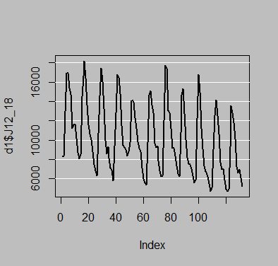
Plotting tips
(par(bg = 'gray'))
plot(d1$J12_18, type=‘l’, lwd=2)
abline(h=seq(from=6000,to=20000, by=2000), col='white')

Slide 5
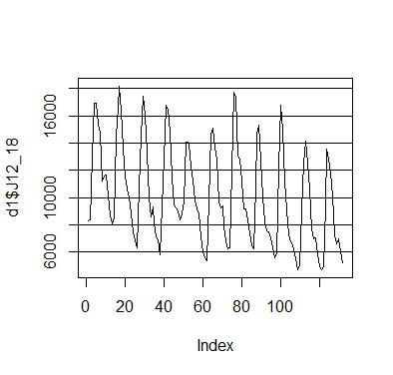
Get rid of gray background
(par(bg = 'white'))
plot(d1$J12_18, type='l')
abline(h=seq(from=6000,to=20000, by=2000), col='black')

Slide 6
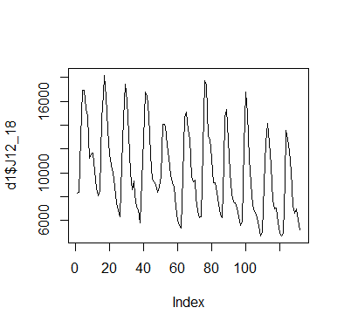
Get rid of horizontal guidelines “Chart junk”
plot(d1$J12_18, type='l')

Slide 7
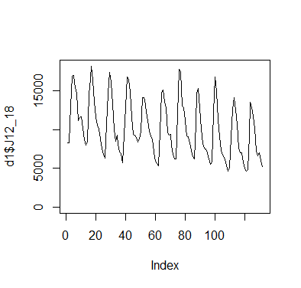
Extend y axis to 0
plot(d1$J12_18, type='l', ylim=c(0, max(d1$J12_18)))

Slide 8
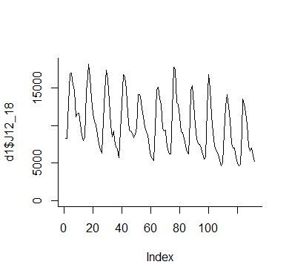
Remove unnecessary borders
plot(d1$J12_18, type='l', ylim=c(0, max(d1$J12_18)), bty='l')

Slide 9
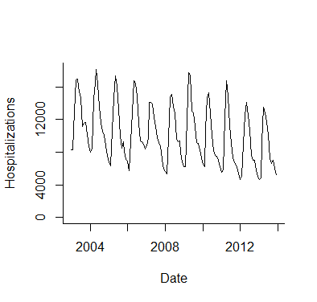
Fix axes
plot(as.Date(d1$date),d1$J12_18, type='l', ylim=c(0, max(d1$J12_18)), bty='l',
ylab="Hospitalizations", xlab='Date', xaxt='n', yaxt='n')
date.labs<- as.Date(c("2004-01-01",'2006-01-01','2008-01-01', '2010-01-01','2012-01-01','2014-01-01'))
axis(side=1, at=date.labs, labels=c("2004","2006","2008","2010","2012","2014"))
axis(side=2, at=seq(from=0,to=20000, by=4000), labels=T)

Slide 10
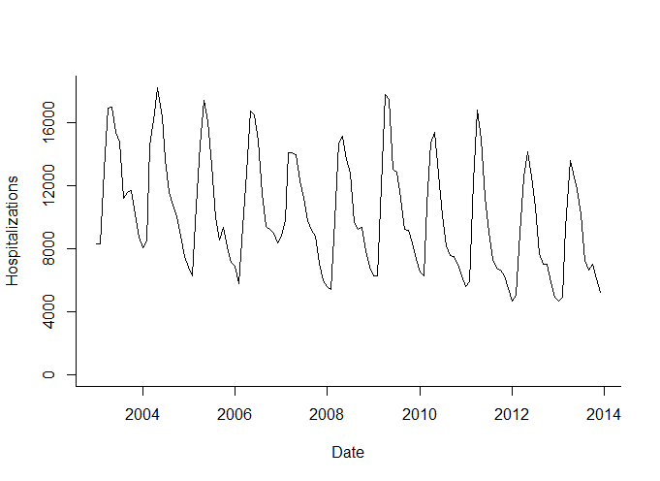
Stretch x-axis

Slide 11
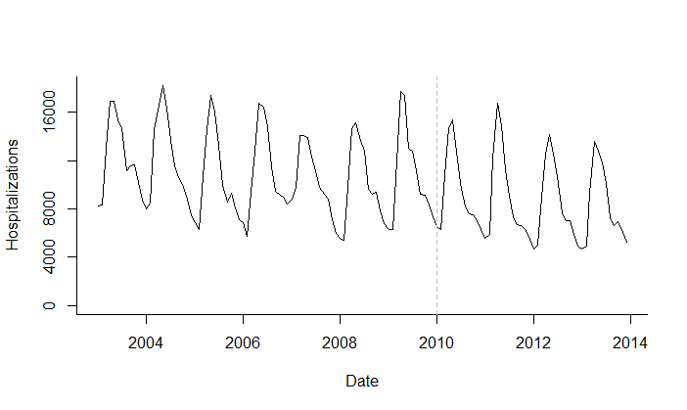
Add ref line
abline(v=(as.Date("2010-01-01")), lty=2, col='gray')

Slide 12
Increase resolution
tiff('C:\\Users\\dmw63\\Desktop\\finalplot.tif', width =6, height = 4, units = "in",res=800)
plot(as.Date(d1$date),d1$J12_18, type='l', ylim=c(0, max(d1$J12_18)), bty='l',
ylab="Hospitalizations", xlab='Date', xaxt='n', yaxt='n')
date.labs<- as.Date(c("2004-01-01",'2006-01-01','2008-01-01', '2010-01-01','2012-01-01','2014-01-01'))
axis(side=1, at=date.labs, labels=c("2004","2006","2008","2010","2012","2014"))
axis(side=2, at=seq(from=0,to=20000, by=4000), labels=T)
abline(v=(as.Date("2010-01-01")), lty=2, col='gray')
dev.off()

Slide 14
In SAS
proc template;
define style nicestyle;
parent=styles.default;
class graphwalls /
frameborder=off;
class graphbackground /
color=white;
end;
run;
ODS listing IMAGE_DPI=800 style=nicestyle;
ods graphics on/ border=off width=6in height=4in ;
proc sgplot data=ds1;
series x=date y=J12_18/
lineattrs=(thickness=1 pattern=solid color=black);
run;

Slide 15
Using colors
http://colorbrewer2.org
RColorBrewer package
library(RColorBrewer)
display.brewer.all()
pal1<- brewer.pal(4, 'Set1’) #4 color palette from color Set1

Slide 16
library(RColorBrewer)
display.brewer.all()
pal1<- brewer.pal(4, 'Set1')
tiff('C:\\Users\\dmw63\\Desktop\\finalplot.tif', width =6, height = 4, units = "in",res=800)
plot(as.Date(d1$date),d1$J12_18, type='l', ylim=c(0, max(d1$J12_18)), bty='l',
ylab="Hospitalizations", xlab='Date', xaxt='n', yaxt='n')
points(as.Date(d1$date), d1$A00_A09, col=pal1[1], type='l')
points(as.Date(d1$date), d1$E00_99, col=pal1[2], type='l')
points(as.Date(d1$date), d1$I00_99, col=pal1[3], type='l')
points(as.Date(d1$date), d1$ach_noj, col=pal1[4], type='l')
date.labs<- as.Date(c("2004-01-01",'2006-01-01','2008-01-01', '2010-01-01','2012-01-01','2014-01-01'))
axis(side=1, at=date.labs, labels=c("2004","2006","2008","2010","2012","2014"))
axis(side=2, at=seq(from=0,to=20000, by=4000), labels=T)
abline(v=(as.Date("2010-01-01")), lty=2, col='gray')
dev.off()

Slide 17
Wrapping up the case

Slide 18
A reminder about who we are
We are working as consultants to the Pan American Health Organization on the evaluation of PCVs in Latin America
We are expected to present the findings of our analyses to different stakeholders

Slide 19
Keys for presentations
Make a credible, transparent of the analyses
Technical detail must be appropriate for audience
Use graphs and summary statistics sparingly but strategically

Slide 20
6 groups for today. Presenting to:
Brazilian Ministry of Health (higher-ups)
Brazilian Ministry of Finance (higher-ups)
Field epidemiologists in Ministry of Health
Gates Foundation
PAHO/WHO
National Immunization Technical Advisory Groups (NITAG)

Slide 21
Today’s task
30 minutes: huddle with your groups to discuss:
1) What does your stakeholder most want to know?
2) Which analyses and sets of results will you present? 2a) How much do the results depend on the method used for analysis?
3) How can you best summarize the findings in a single plot?
4) What is going to be your final estimate for vaccine
effect?

